Slide 1

How CFEED Research Helped Shape
the Osceola Prosper Program
Ashton Terry
Senior Manager
The School District of Osceola County, FL

Slide 2
How CFEED Research Helped Shape the Osceola Prosper Program
Ashton Terry-CFEED Senior Manager, The School District of Osceola County, Florida
Session Agenda
-Kahoot Pop Quiz: What do you already know about CFEED research?
-Innovative CFEED Research: Acceleration, Post-Secondary Readiness, Post-Secondary Progression, and Chronic Absenteeism
-The Birth and Progression of Osceola Prosper
-Around the World Activity
  Your biggest takeaway from this session
  One new research idea that CFEED could help your organization with
  One question you still have
  While you’re at it…network and make a new friend ☺
-Q&A / Feedback
-Thank you for being here!

Slide 3





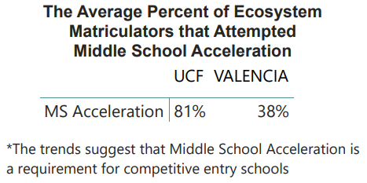
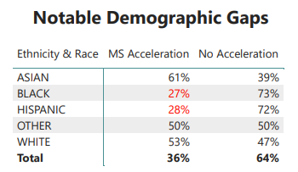

CFEED
Acceleration
-CFEED knows which students have been able to accelerate as early as middle school. Middle school acceleration is key for continued success in high school and post-secondary education.
High School Graduation
Valencia
Enrollment
UCF
Enrollment
Middle School Acceleration
High School Acceleration
Dual Enrollment Readiness
College
Graduation

Slide 4
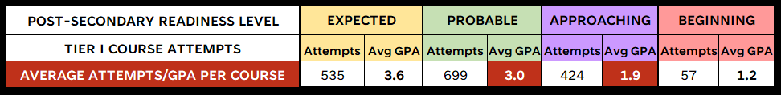
CFEED
Acceleration
-CFEED has developed a Tiered system of high school coursework.
Students who complete around five core accelerated courses with roughly a B average are generally found to be post-secondary ready.
High School Graduation
Valencia
Enrollment
UCF
Enrollment
Middle School Acceleration
High School Acceleration
Dual Enrollment Readiness
College
Graduation
Post-Secondary Readiness
-Based on years of data, CFEED has also created four levels of post-secondary readiness based high school accelerated course performance data. This data is provided to each district so that schools can assess next steps with each student.
Expected or Probable | READY
Approaching or Beginning | NOT YET READY

Slide 5
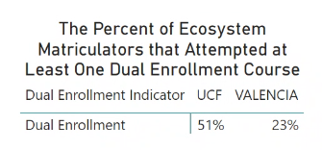
CFEED
Post-Secondary Readiness
-Schools can use readiness levels to quickly find students who are ready for Dual Enrollment. This can help bridge the gap shown in recent years, with only about 15% of Dual Enrollment-ready students participating.
High School Graduation
Valencia
Enrollment
UCF
Enrollment
Middle School Acceleration
High School Acceleration
Dual Enrollment Readiness
College
Graduation
-In 2022-2023, our data showed that over 99% of seniors who participated in Dual Enrollment showed either Expected or Probable levels of readiness. Valencia and school district leaders have discussed using CFEED’s measure as qualification for a student to begin, to eliminate the barrier of entry testing.
2022-2023 Projected CFEED High School Seniors | DE Readiness Count of DE Enrolled Students | DE Not Ready Count of DE Enrolled Students | Readiness Percentage of DE Enrolled Students
DE Enrollment Count | DE Readiness Count of DE Enrolled Students | DE Not Ready Count of DE Enrolled Students | Readiness Percentage of DE Enrolled Students
1,358 | 1,347 | 11 | 99.2%

Slide 6
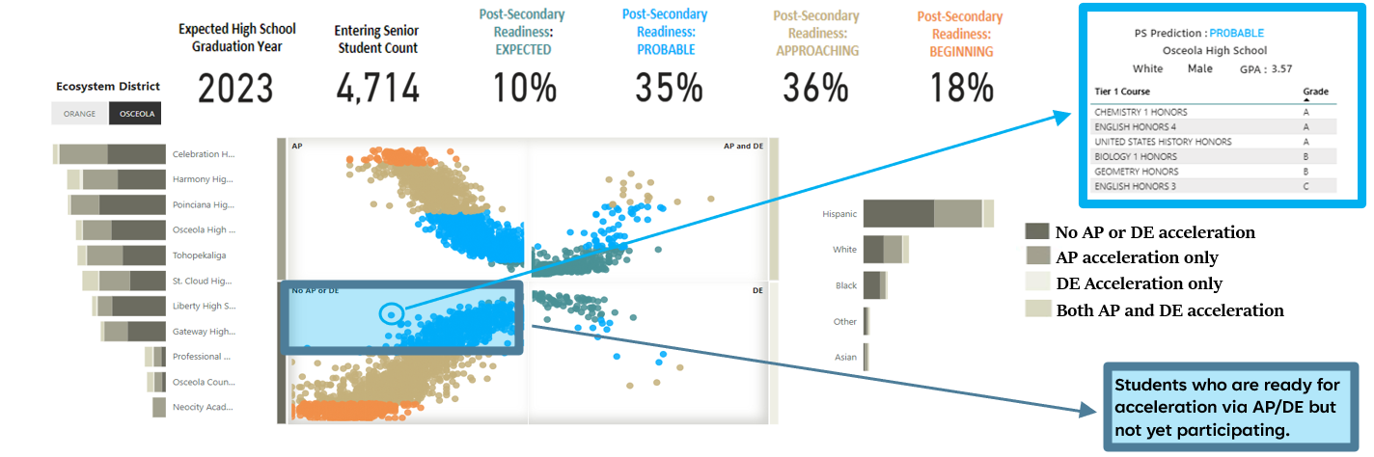
CFEED
Post-Secondary Readiness
-With CFFED’s exportable interactive dashboard, the capability exists to ensure each high school in OCPS and SDOC has this information at their fingertips. For schools who focus more on Advanced Placement, or students who do not wish to enroll in Dual Enrollment, we are also able to identify students at each readiness level who have not yet taken AP or DE courses.

Slide 7
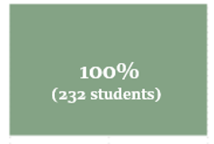
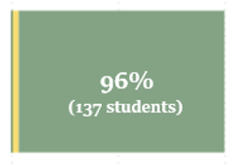
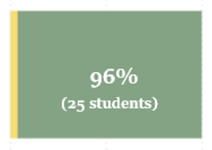
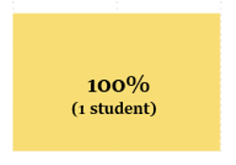


CFEED
Post-Secondary Progression
-We have conducted deep dives into effects from initial coursework taken at Valencia. By finding successful course patterns of students entering Valencia not yet ready for post-secondary coursework, more students can have an opportunity to progress at the school.
High School Graduation
Valencia
Enrollment
UCF
Enrollment
Middle School Acceleration
High School Acceleration
Dual Enrollment Acceleration
College
Graduation
-CFEED found a success pattern in which 96% of Approaching (not yet ready) students successfully passed Statistical Methods during their first term at Valencia, making them 2-3 times less likely for attrition.
Valencia Statistical Methods
Enrollment by Readiness
Group-401 total students
Expected
Probable
Approaching
Beginning
Passed Course

Slide 8
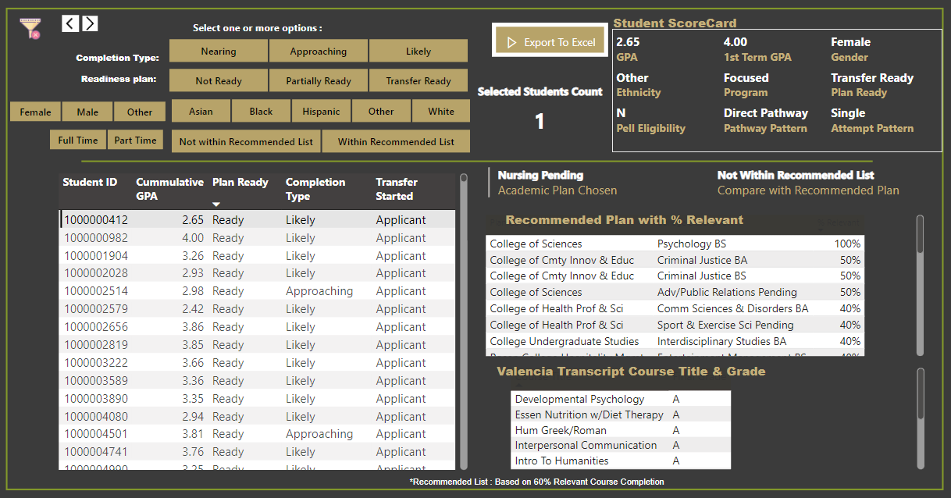
CFEED
Post-Secondary Progression
-CFEED has produced a model of Valencia to UCF transfer readiness by measuring the alignment of course history to a student’s selected program. This information can be used to provide additional support to students to best prepare for the transition to UCF.
-CFEED has also developed a method to align relevant programs for Valencia to UCF transfer students who have not yet decided on a program of study. There is potential to help thousands of students align more closely to a program of study at UCF.
Middle School Acceleration
High School Acceleration
Dual Enrollment Acceleration
Valencia
Enrollment
UCF
Enrollment
High School Graduation
College
Graduation

Slide 9
CFEED
Chronic Absenteeism Research
-CFEED’s findings show an increasing trend of Repetitively Chronically Absent students within Central Florida
(absent for ten or more days for at least four school years).
Expected Graduation Year | 2017 | 2018 | 2019 | 2020 | 2021 | 2022
0 to 3 Years of Chronic Absences | 77% | 75% | 72% | 71% | 71% | 67%
4 or More Years Chronically Absent | 23% | 25% | 28% | 29% | 29% | 33%
-CFEED also found a noticeable relationship between chronic absenteeism and low academic performance. Of students expected to graduate in 2022, around 25% of students who were ready for post-secondary coursework (Expected or Probable groups) were Repetitively Chronically Absent, compared to 50% of students who were not ready (Approaching or Beginning). The CFEED team plans to do further research surrounding attendance in the future.
Percent of Repetitively Chronically Absent Students, by Post-Secondary Readiness Group and Graduation Year
2017
2018
2019
2020
2021
2022
2017
2018
2019
2020
2021
2022
2017
2018
2019
2020
2021
2022
2017
2018
2019
2020
2021
2022
Expected
Probable
Approaching
Beginning

Slide 10



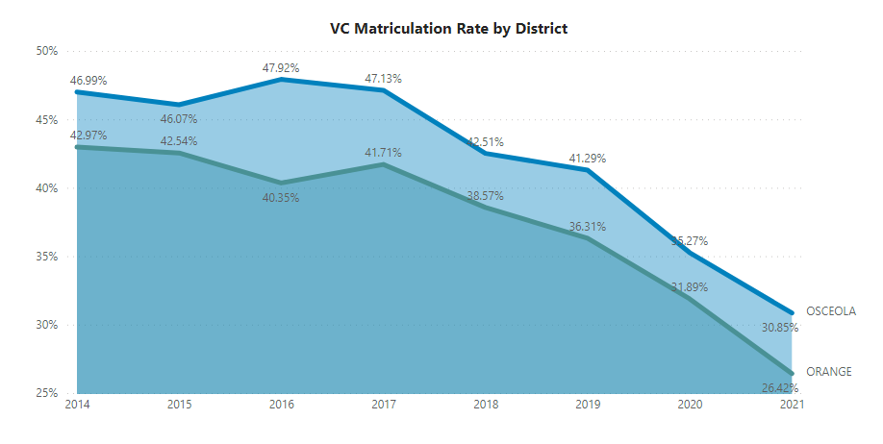
CFEED
Osceola Prosper
-Osceola Prosper was born in 2022 after extensive collaboration between Valencia College, Osceola County Commissioners, and The School District of Osceola County. These leaders utilized a variety of data in their decision-making, including CFEED research which showed years of decline in enrollment in Valencia. Goals of this program were to increase matriculation to Valencia, and to find a way for students to earn an Associate’s Degree with zero student loan debt.
-Every student who graduates from SDOC, including public, private, charter, and home school, is eligible for Osceola Prosper. The program allows these high school graduates to attend Valencia College or Osceola Technical College for free and does not include any test score or GPA requirements.
Matriculation to Valencia
by OCPS and SDOC graduates, 2014-2021
Matriculation to Valencia
by OCPS and SDOC graduates, 2014-2021
Graduation Progression Group | 2019 Student Count
0-14 Credits | 5,502
15-29 Credits | 4,444
30-44 Credits | 3,618
45-59 Credits | 2,905
60+ Credits | 2,319
TOTALS | 18,788
2021 Student Count | Decrease by Progression Group
3,707 | 1,795
2,512 | 1,932
1,331 | 2,287
642 | 2,263
390 | 1,929
8,582 | 10,206

Slide 11
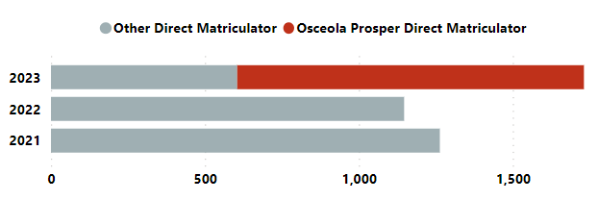
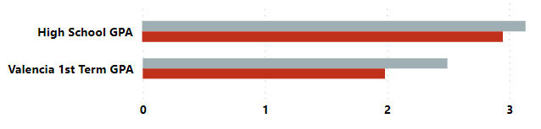
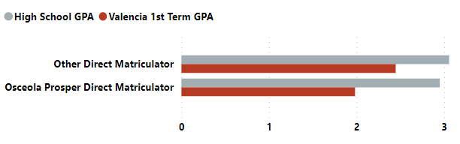
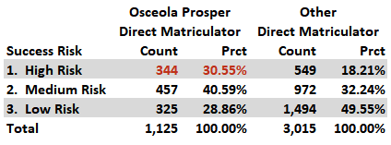
01
CFEED
Osceola Prosper
-Osceola Prosper has successfully increased matriculation into Valencia College. As our continued research shows that Osceola Prosper students have greater risk rates than other matriculators, a next step is to provide ongoing support to these students.
Direct matriculation from SDOC into Valencia increased by 679 students which is a 44% increase from academic years 2021 and 2022.
CFEED has identified 1,126 Osceola Prosper Scholarship students who directly matriculated from SDOC core high schools into Valencia. These students graduated from SDOC in 2022 and began coursework at Valencia in 2023.
Key Insights for Prosper Students:
The Osceola Prosper direct matriculators showed a 0.53-point decrease in their Valencia 1st term GPA when compared to other direct matriculators.
This same cohort of students are needing more support to complete their AA or AS program. There are 344 students who directly matriculated under the Prosper program that are "High Risk" of attritting from Valencia.

Slide 12
CFEED
Osceola Prosper
-As we have had success aligning course patterns to progression at Valencia, CFEED is closely monitoring common course enrollments among Osceola Prosper cohorts.
-CFEED is also able to embed demographic data as we track Osceola Prosper progress. As shown, we can explore enrollment by gender and ethnicity, tying in academic background such as our post-secondary readiness measure, high school GPA, etc.
Top 10 Most Common Course Enrollments by the Graduation Class of 2022 attending Valencia via Osceola Prosper
Academic/Demographic Trends within the Graduation Class of 2022 attending Valencia via Osceola Prosper
Course Title | Enrollment Count | Percent of Cohort
Freshman Comp I | 260 | 18%
New Student Experience | 255 | 17%
Freshman Comp II | 193 | 13%
College Algebra | 174 | 12%
U.S. Government | 151 | 10%
Intro to Humanities | 144 | 10%
Fundamentals of Speech | 134 | 9%
Intermediate Algebra | 121 | 8%
General Psychology | 94 | 6%
U.S. History 1877 to Present | 88 | 6%
Ethnicity / Gender | Student Count | Percent of Cohort | Post-Secondary Readiness % | Average HS GPA
Female | 838 | 59% | 79% | 3.2
Male | 597 | 41% | 63% | 2.9
Asian | 49 | 6% | 76% | 3.2
Black | 132 | 6% | 46% | 2.9
Hispanic | 960 | 67% | 55% | 3.1
White | 222 | >1% | 77% | 3.2
Other Ethnicity | 74 | >1% | 57% | 3.1

Slide 13
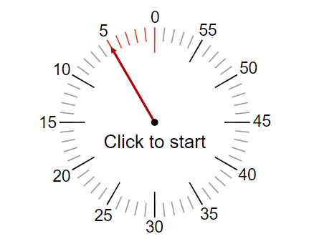
CFEED
Team Activity
-I invite you to stand up and take a moment to visit each of the three stations around the room. I also challenge you to make a new friend ☺
-At each station, please follow the prompt on the chart paper, take a sticky note, and provide your input.
-In five minutes, we will come back to share out and reflect the content at each station. I will answer any questions and then we are done!!

Slide 14
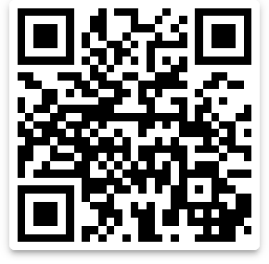
CFEED
Q&A / Feedback?
-Thank you for attending this session. Please reach out anytime if you have questions or if CFEED can be of service to your organization!
Ashton Terry
Senior Manager, Central Florida Education Ecosystem Database (CFEED)
Research, Evaluation & Accountability Department
ashton.terry@osceolaschools.net
LinkedIn QR Code Below-Let’s Connect!

