Slide 1



CFEED
Communications
Approval Process & Review of Post-Secondary Readiness Infographic
September 2023

Slide 2

Agenda
01
Approval Process
02
Feedback
High level introduction for a communications approval process
Give Feedback on the
4 Levels of Post Secondary Readiness Infographic

Slide 3
CFEED Communication Review
01
1. CFEED Research Team
3. CFEED Communication Team
Data & Analytics
Story Telling & Visual Design
Final Publishing
2. Insights Review
4. Communication Governance
Review with Analysts & Leadership
Public facing & sensitive documents
go through Governance team

Slide 4
Communication Approval Process:
01
Most communications will go through steps 1-3.
Public facing & sensitive documents may need to go through
the Communication Governance team.
What we need input on:
Data sensitivity: What data are we allowed to release & when? Who needs sign off?
Review Infographics: Pros & Deltas (opportunities for change)
Please know, for future communications, you may receive an email with a survey or approval form for signoff on website, article or infographic communications.

Slide 5
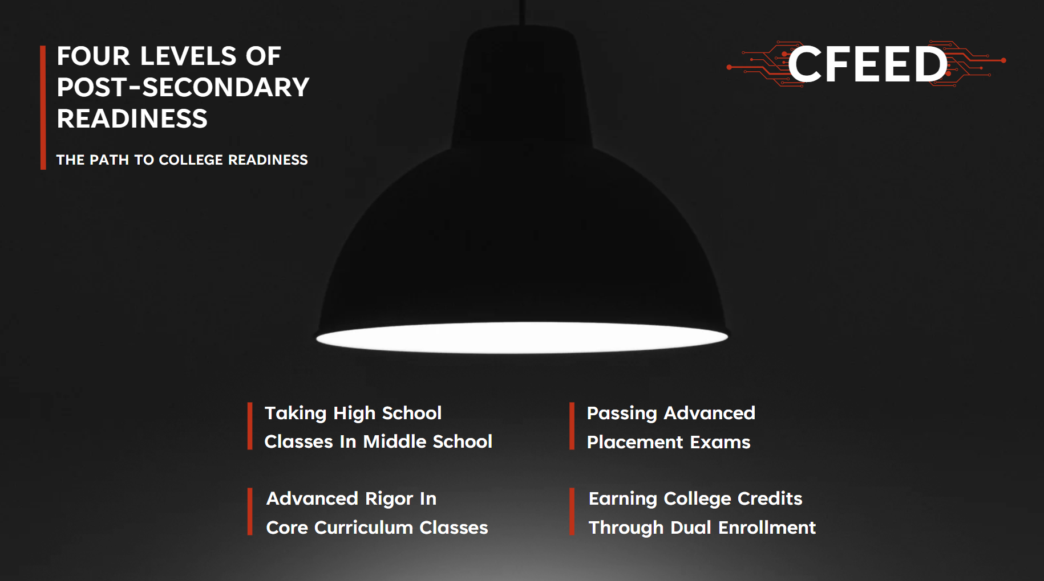

Slide 6
